Slide 1
INTRODUCTION TO DRUG REGULATORY AFFAIRS

Slide 2
ICH Guidelines
International Conference on Harmonisation
Regulatory Authorities of Europe, Japan and USA- scientific and technical aspects of product registration

Slide 3
Overview
Initiation of ICH harmonisation action
Full ICH Process

Slide 4
Abbreviated Process
Updating based on new information

Slide 5
Initiation
New types of medicinal product
Lack of harmonization in current technical requirements
Transition to technically improved testing procedures
Review of existing ICH guideline
Maintenance of an Existing Guideline

Slide 6
Preparation of Concept Paper by the party proposing a new harmonisation action.
Selection of Procedure- Full ICH process except for maintenance of existing guideline

Slide 7
Full ICH Process
Concept paper sent to members of the Steering Committee
If the topic is worthwhile, the Steering Committee will confirm the composition of the Expert Working Group formed to discuss the technical issues.
A timetable and action plan is set for the EWG

Slide 8
ICH parties will designate a topic leader for the new topic.
Observes to ICH will nominate an expert to the EWG.
EWG reports to the Steering Committee
Consensus building
Sign-off by EWG members

Slide 9
Agreement confirmed by steering committee
Regulatory Consultation- published in USFDA, EU etc
Adoption of a tripartite harmonised text
Implementation
ABBREVIATED PROCESS FOR MAINTENANCE OF ICH AGREEMENTS- for minor changes

Slide 10
US FDA
Federal Agency
Regulation and supervision of
Food Safety
Tobacco Products
Prescription and OTC pharmaceuticals
Dietary Supplements
Vaccines, Biopharmaceuticals, Medical Devices etc

Slide 11
CFR: Title 21
Related to Food and Drug Administration
Part 210: CGMP general related to drugs (general)
Part 211: CGMP of Finished Pharmaceuticals-
Various parts including Organization, Building and Facilities, Personnel, Equipment and Controls, Containers and Closures, Production and Process Controls, Packaging and Labelling Control etc
Part 310: New Drugs
Part 311: Investigational New Drug Application
Part 600: Biological Products

Slide 12
Why does US FDA evaluate drugs?
Does FDA test drugs?
Why clinical trials?
How long does it take for approval?
What are the different types of New Drug Applications?

Slide 13
Centre for Drug Evaluation and Research of US FDA
Ensure Safe and Effective Drugs are available
FDA does NOT test drugs- responsibility of company to show data about efficacy and safety
Clinical Trials: Demonstrate safety and efficacy

Slide 14
Approval of Drug- Two-tiered system
Standard: Drugs with minor improvement- 10 months
Priority- Major advances- 6 months
OTC Products
Types of Drug Applications
Investigational New Drug
New Drug Application
Abbreviated New Drug Application (ANDA)

Slide 15
WHO
WHO
Established in 1948
192 member states
Approve budget
Major Policy Decisions
Established in 1948
192 member

Slide 16
Functions of WHO
Co-ordinating Authority on International Health
Collaboration with various governmental and other health agencies
Assist in strengthening health services

Slide 17
Functions of WHO
Propose guidelines for technical matters related to health
Epidemiological and Statistical services
Develop and Promote international standards for food, biological and pharmaceutical products

Slide 18
WHO Guidelines
Development: Quality built into product
Production: GMP
Quality Control: Ensure quality of product
Inspections: Monitor and Enforcement of GMP
Related regulatory aspects: Stability, Packaging, Storage
Distribution: Supply chain

Slide 19
European Medicines Agency
Started in 1995
Protection and promotion of public and animal health
Functions
Technical advice and scientific guidance to sponsors for new drug referrals
Safety Monitoring or Pharmacovigilance (PRAC)- monitoring safety of medicines, making recommendations

Slide 20
EMA works by
providing specific support to pharmacovigilance activities for centrally authorised products, in particular through risk-management plans;
developing guidelines and setting standards;
coordinating the monitoring of pharmaceutical companies' compliance with their pharmacovigilance obligations;
informing the public on the safety of medicines and cooperating with all external parties, in particular through the Agency's interaction with representatives of patients and healthcare professionals;
contributing to international cooperation activities with authorities outside the EU.

Slide 21
Therapeutic Goods Administration (TGA)- Australia
The TGA regulates the supply of:
medicines prescribed by a doctor or dentist, pharmacy, supermarkets
complementary medicines, these include vitamins, herbal and traditional medicines
medical devices, from simple devices like bandages to complex technologies like heart pacemakers
products used to test for various diseases or conditions (in vitro diagnostic devices), such as blood tests; and
vaccines, blood products, and other biologics.
and the manufacturing and advertising of these products.

Slide 22
Medicines & Healthcare products Regulatory Agency (MHRA)- UK
The MHRA regulates medicines, medical devices and blood components for transfusion in the UK.

Slide 23
The agency is responsible for:
ensuring that medicines, medical devices and blood components for transfusion meet applicable standards of safety, quality and effectiveness
ensuring that the supply chain for medicines, medical devices and blood components is safer and more secure
promoting international standardisation and harmonisation to assure the effectiveness and safety of biological medicines
helping to educate the public and healthcare professionals about the risks and benefits of medicines, medical devices and blood components, leading to safer and more effective use
supporting innovation and research and development that’s beneficial to public health
influencing UK, EU and international regulatory frameworks so that they’re risk-proportionate and effective at protecting public health

Slide 24
ICH- four topics
Quality: Stability, Impurity profile, GMP, Quality systems
Safety: Potential risks such as Genotoxicity, Carcinogenicity
Efficacy: Design, Conduct and Safety of Clinical trials
Multidisciplinary: Miscellaneous

Slide 25
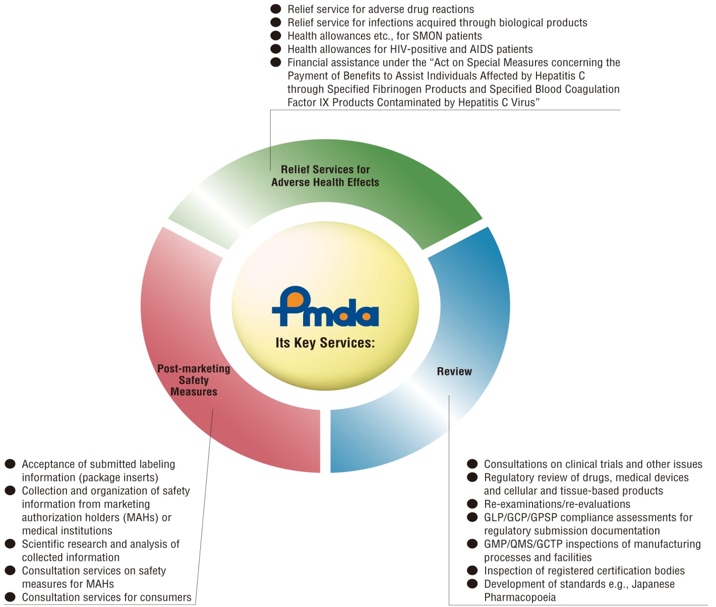
PMDA- Pharmaceuticals and Medical Devices Agency- Japan

